Slide 1


24-hour programming contest!

Slide 2
IEEE Mission & Vision
Mission statement
IEEE's core purpose is to foster technological innovation and excellence for the benefit of humanity.
Vision statement
IEEE will be essential to the global technical community and to technical professionals everywhere, and be universally recognized for the contributions of technology and of technical professionals in improving global conditions.
Notes:
Engineers and technologists are, fundamentally, problem solvers. Presented with a challenge, they work to solve it by reimagining and repurposing existing technologies or by creating entirely new solutions. At IEEE, the world’s largest technical professional organization dedicated to advancing technology for the benefit of humanity, it’s our
job to empower this “can do” spirit, which engineers and technologists carry in their DNA.

Slide 3

Introduction
The Institute of Electrical and Electronics Engineers (IEEE, pronounced "I triple E") is a professional association. It was formed in 1963 from the amalgamation of the American Institute of Electrical Engineers and the Institute of Radio Engineers. Today, it is the world's largest association of technical professionals with more than 400,000 members in chapters around the world.
Notes:
At IEEE we are inspired by these innovators and strive to inspire the next generation of innovators through our efforts on behalf of the engineering, computing, and technology professions. In support of IEEE’s mission, we work to ensure that today’s technology professionals have the information they need to continue their pursuit
of innovation as they develop technologies that benefit people everywhere.

Slide 4
IEEEXtreme
IEEEXtreme is a global challenge in which teams of IEEE Student members—advised and proctored by an IEEE member, and often supported by an IEEE Student Branch—compete in a 24-hour time span against each other to solve a set of programming problems. IEEEXtreme 10.0 will be held on 22 October 2016. Save the date. Thank you to all the past participants, and a warm welcome to all future programmers. You think you can <code> ?
Notes:
IEEEXtreme Competition Grows in Strength
More than 6,400 students from 76 countries, an increase of nearly 900 students and 16 countries from 2015, competed in one of the most dynamic and intense coding competitions around: IEEEXtreme. The 24-hour contest, which continues to grow in popularity, brings together IEEE student members from around the world to solve programming challenges that they might be confronted with in the real world. All told, 2,477 teams entered the competition. Now in its eighth year, IEEEXtreme has its own community on IEEE Collabratec, with nearly 2,000 members. To encourage more students to participate and help them prepare for next year’s contest, volunteers are developing tutorials and videos that explain how to conquer the competition’s various programming challenges.

Slide 5






History
IEEEXtreme began in 2006, has been hosted for 9 different years,
and will enjoy its 10th year of competition in October, 2016.
The first competition in 2006 attracted 47 teams with 150 participants.
The most recent iteration of IEEEXtreme, in 2015, enjoyed the registration of over 2,477 teams, participation of over 1,900 teams, 6,400+ student competitors, 600+ proctors, and 100+ volunteers around the world.

Slide 6
Format
Teams of up to three student IEEE members
Solve a sets of programming problems over 24 hours, starting at 0:00 GMT on the competition date.
All teams receive the same problems to solve and are expected to solve the problems without direct outside consultation.
Teams don’t need to tackle every problem, but the more they solve, the more points they score.
Students submit their solutions using an online tool, which has been HackerRank in recent years. Points are awarded based on how the problem was solved, the time it took, and its difficulty. Higher-grade IEEE members serve as judges and proctors for the competition.

Slide 7
IEEEXtreme Stats

Slide 8
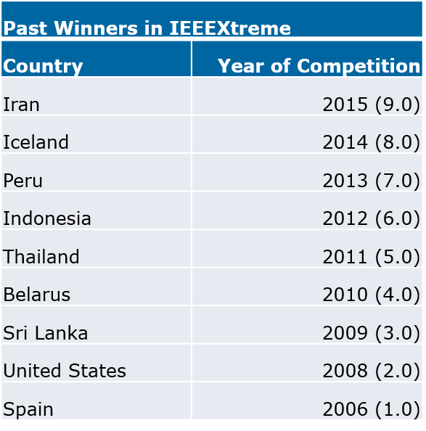
IEEEXtreme past winners
Participation is a key to Win! http://xtreme.vtools.ieee.org/

Slide 9
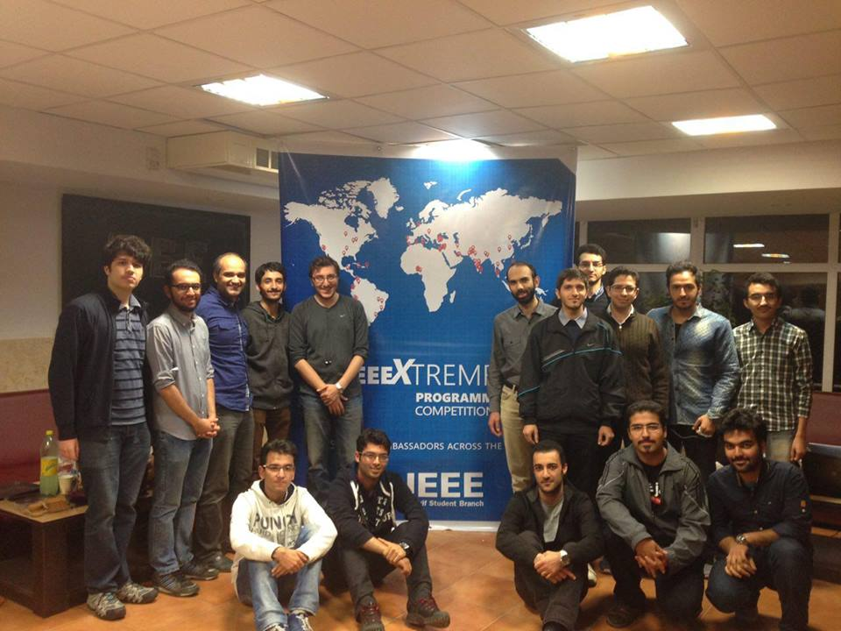
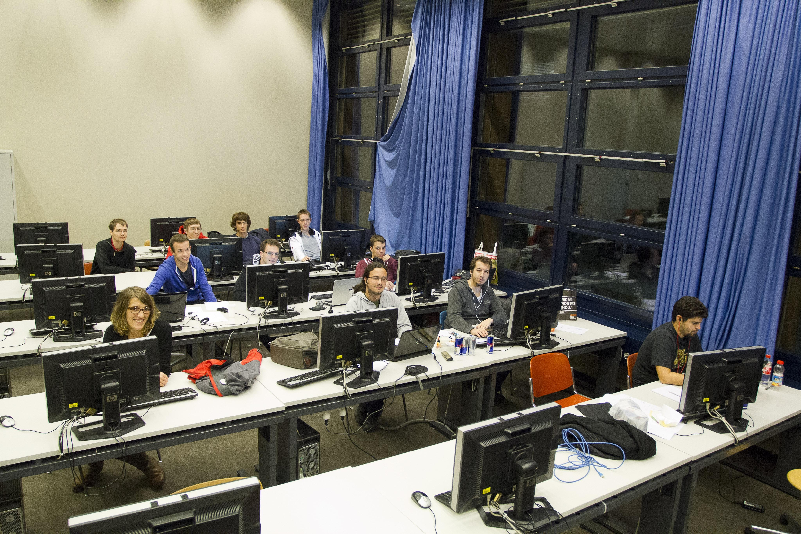
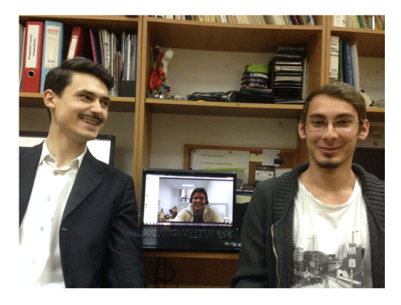
Top IEEEXtreme 9.0 winners
Team Name: TeamName
University :Sharif University of Technology
from Iran Region 8
Team Name: EPFL1
University: Ecole Polytechnique Federale de Lausanne (EPFL) from Switzerland Region 8
Team Name: Powerhouse
University: Politehnica University of Bucharest Romania 8

Slide 10
Why participate ?
For Fun
Glory
Community
Learning
Sharpen your programming skills
Get hired by top companies
And More..
Notes:
What is the purpose of solving challenges?
For Fun. What can be more exciting than solving challenging problems? We have also added helpful features to make your coding experience enjoyable, such as providing boilerplate code and displaying animations of your running code.
Glory. As you solve more challenges, you will earn points, and move up in the HackerRank Leaderboard. Many challenges will also involve a competition between your bots and the bots coded by other hackers, so may the best hacker win!
Community. We are building a community of hackers who will be able to discuss problems, learn, compete and collaborate together.
Learning . You will be able to learn new programming topics and techniques by going through the challenges on HackerRank. We believe the way to learn something is by doing it.
And More.

Slide 11

Practice Community
https://www.hackerrank.com/ieeextreme-challenges
Notes:
Rules:
# Please refrain from discussing strategy during the contest.
# Any case of code plagiarism will result in disqualification of both the users from the contest. We've a fairly good plagiarism detector that works at the opcode level.
# You can code directly on our interface. We support 20 major languages. You can have a look at the environment in which we run your code. You can try out sample code given in Solve Me First to get familiar with I/O.
# HackerRank admins decision will be final
Scoring:
# Each challenge has a pre-determined score.
# Each submission for each problem will be scored, based on number of testcases it passes.
# The total score of any participant is the sum of their maximum scores of each of the attempted problems.
# Participants are ranked according to their scores. Cumulative time taken to solve the challenge is used as a tie-breaker.

Slide 12

Important Dates
Registration for IEEEXtreme 10.0 is now open! Link is below! http://xtreme.vtools.ieee.org/

Slide 13
Q & A
# include <skills.h>
# include <knowledge.h>
void main (participate)
{
printf (“Thank You !!”);
getch();
}

